Slide 1
CS 211 Computer Architecture Lecture 41: Virtual Memory Part-3 Protection, TLB, Hierarchical Page Table
Ravi Mittal
ravi.mittal@iitgoa.ac.in
Indian Institute of Technology, Goa

Slide 2
We will study today ..
Virtual Memory Basics (Revision)
Virtual Memory Examples
Protection provided by Virtual Memory
Speeding up – Address Translation using TLB
Page Table Size Issue Solution: Hierarchical Page Table
Intel Core i7 Memory System
TLBs in Datapath
Virtual Memory Summary

Slide 3
Acknowledgements
Morgan Rae Reschenberg, CS 61C: Great Ideas in Computer Architecture (Machine Structures), http://inst.eecs.berkeley.edu/~cs61c/
Krste Asanović & Randy H. Katz, CS 61C: Great Ideas in Computer Architecture (Machine Structures), http://inst.eecs.berkeley.edu/~cs61c/
Chapter 6, Memory Hierarchy, Book: Computer Systems: A programmer’s perspective, Randal E. Bryant and David R. O’Hallaron
Prof Onur Mutlu’s Class Presentation, ETH Zürich, Lecture 21b: Memory Hierarchy and Caches, Sprint 2020
Patterson and Hennessy, Book: Computer Organization and Design, Hardware/Software Interface, RISC-V Edition
MIT 6.004 Spring 2020, Class on Caches
Digital Design and Computer Architecture: RISC-V Edition, Harris & Harris Elsevier

Slide 4
Last Class

Slide 5
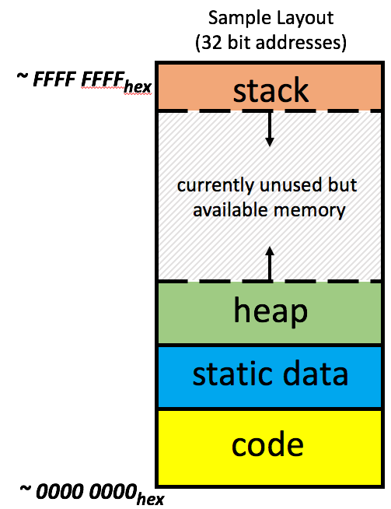
Each process has it’s own (virtual) address space
Process 1
Process 2
Process n

Slide 6
Virtual vs. Physical Addresses
Memory manager
Processor (& Caches)
?
Memory (DRAM)
Control
Datapath
Virtual Address
PC
Physical Address
Bytes
Registers
(ALU)
Many of these (software & hardware cores)
One main memory
Each Process uses it’s own address space
Processes use virtual addresses, e.g., 0 … 0xffff,ffff
Many processes, all using same (conflicting) addresses
Memory uses physical addresses (also, e.g., 0 ... 0xffff,ffff)
Memory manager maps virtual to physical addresses

Slide 7
Paged Virtual Memory
Divide virtual memory and physical memory into equally sized segments called pages:
0
1
2
3
4
5
6
7
Virtual Memory
0
1
2
3
Physical Memory
Ref: Morgan Rae Reschenberg, Course 61C, Univ of California, Berkeley

Slide 8
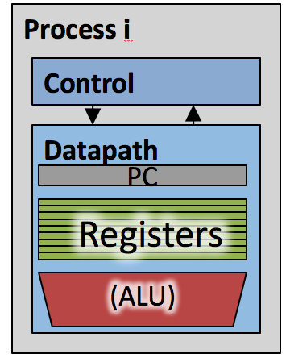
Each Process has a page table
Memory (DRAM)
Page Table
Page N
Page 2
Page 1
Page 0
Page Table
Page Table
Each process has a dedicated page table. Physical memory non-consecutive.

Slide 9
Virtual to Physical Address
Virtual Address
Virtual Page Number
Offset
Page table lookup!
Physical Page Number
Offset
Physical Address
Ref: Morgan Rae Reschenberg, Course 61C, Univ of California, Berkeley

Slide 10
Page Table on Physical Memory
A page table is an array of page table entries (PTEs) that maps virtual pages to physical pages.
For every process there is a page table in Main Memory (DRAM)
Physical memory
(DRAM)
Physical page
number or
disk address
Valid
VP 1
PP 0
PTE 0
0
null
VP 2
1
VP 7
VP 4
PP 3
1
0
1
0
null
Disk memory
0
PTE 7
1
VP 1
Memory resident
page table
(DRAM)
VP 2
VP 3
VP 4
VP 6
Adapted from Bryant and O’Hallaron, Computer Systems: A Programmer’s Perspective, Third Edition
VP 7

Slide 11
Page Hit
Page hit: reference to VM word that is in physical memory (DRAM cache hit)
Virtual Address
Physical memory
(DRAM)
VPN Offset
Physical page
number or
disk address
Valid
VP 1
PP 0
PTE 0
0
null
VP 2
1
VP 7
VP 4
PP 3
1
0
1
0
null
Virtual memory
(disk)
0
PTE 7
1
VP 1
Memory resident
page table
(DRAM)
VP 2
VP 3
Page Not hit: PTE refers to location in swap space on disk
VP 4
VP 6
VP 7
Adapted from Bryant and O’Hallaron, Computer Systems: A Programmer’s Perspective, Third Edition

Slide 12
Address Translation With a Page Table
Virtual address
Page table base register (PTBR)
(CR3 in x86)
n-1
p
p-1
0
Virtual page number (VPN)
Virtual page offset (VPO)
Page table
Valid
Physical page number (PPN)
Physical page table
address for the current
process
Valid bit = 0:
Page not in memory
(page fault)
Valid bit = 1
m-1
p
p-1
0
Physical page number (PPN)
Physical page offset (PPO)
Physical address
Adapted from Bryant and O’Hallaron, Computer Systems: A Programmer’s Perspective, Third Edition

Slide 13
Virtual Memory Examples

Slide 14
Virtual Memory Example
System:
Virtual memory size: 2 GB = 2³¹ bytes
Physical memory size: 128 MB = 2²⁷ bytes
Page size: 4 KiB = 2¹² bytes
Organization:
Virtual address: 31 bits
Physical address: 27 bits
Page offset: 12 bits
# Virtual pages = 2³¹/2¹² = 2¹⁹ (VPN = 19 bits)
# Physical pages = 2²⁷/2¹² = 2¹⁵ (PPN = 15 bits)
Harris and Harris Book: Digital Design and Computer Architecture

Slide 15
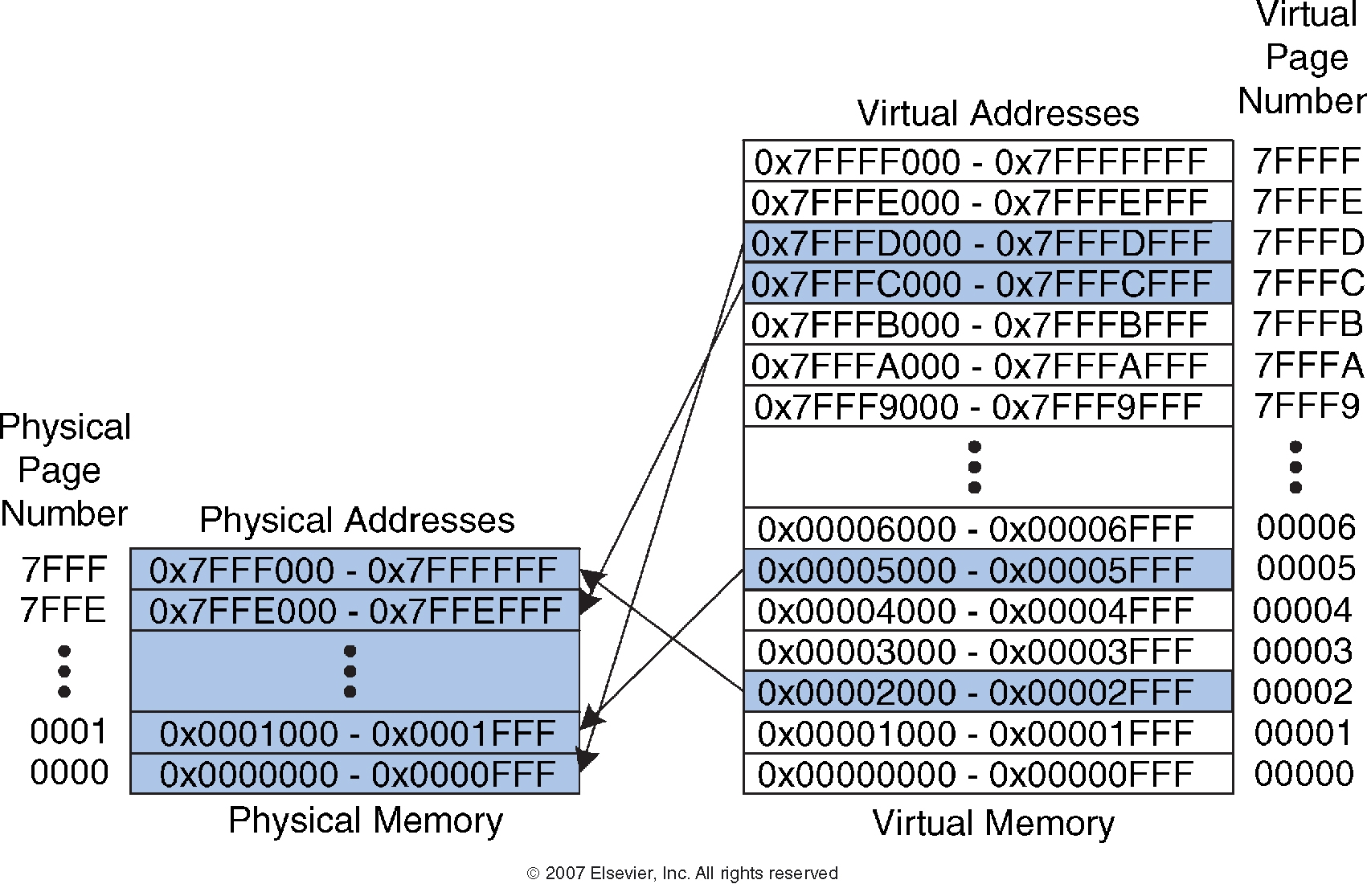
Virtual Memory Example
Harris and Harris Book: Digital Design and Computer Architecture

Slide 16
Page Table Example-1
Harris and Harris Book: Digital Design and Computer Architecture

Slide 17
Virtual Memory: Example - 2
What is the physical address of virtual address 0x5F20?
Harris and Harris Book: Digital Design and Computer Architecture

Slide 18
Virtual Memory: Example - 2
What is the physical address of virtual address 0x5F20?
Virtual Page number: 05
Entry 5 in page table indicates VPN 5 is in physical page 1
Physical address is 0x1F20
Harris and Harris Book: Digital Design and Computer Architecture

Slide 19
Protection Provided by Virtual Memory

Slide 20
VM provides Memory Protection
Extend PTEs with permission bits
MMU checks these bits on each access
Physical
Address Space
Process i:
SUP
READ
WRITE
EXEC
Address
VP 0:
No
Yes
No
Yes
PP 6
VP 1:
No
Yes
Yes
Yes
PP 4
VP 2:
Yes
Yes
Yes
No
PP 2
PP 2
•
•
•
PP 4
PP 6
Process j:
SUP
READ
WRITE
EXEC
Address
PP 8
VP 0:
No
Yes
No
Yes
PP 9
PP 9
VP 1:
Yes
Yes
Yes
Yes
PP 6
VP 2:
No
Yes
Yes
Yes
PP 11
PP 11
SUP: requires kernel mode
Adapted from Bryant and O’Hallaron, Computer Systems: A Programmer’s Perspective, Third Edition

Slide 21
Speeding up – Address Translation using TLB (Translation Look Aside Buffer)

Slide 22
Virtual Memory Problem
Two or more physical memory accesses per data access
SLOW
Since there is locality in pages of data, there must be locality in the translations of those pages
Build a separate cache for the Page Table
For historical reasons, cache is called a Translation Lookaside Buffer (TLB)
TLB stores: VPN → PPN mappings

Slide 23
TLBs and Caches
Data at memory address
Memory Address
TLB
Data Cache / Instruction Cache
VPN
PPN
On miss:
Access Page Table in main memory
On miss:
Access next cache level / main memory
TLBs usually small, typically 32–128 entries
TLB access time is comparable to that for cache (much faster than accessing main memory)
TLBs usually are fully/highly associativity
Each entry maps a large page, hence less spatial locality across pages
Sometimes larger TLBs (256-512 entries) are 4-8 way set-associative
Ref: Morgan Rae Reschenberg, Course 61C, Univ of California, Berkeley

Slide 24
TLB and Cache
hit
miss
CPU
TLB
Cache
Main Memory
VA
PA
data
miss
hit
PPN
Page Table
VPN
Now the TLB does the translation too, not just the Page Table!
Ref: Morgan Rae Reschenberg, Course 61C, Univ of California, Berkeley

Slide 25
Fetching Data on a Memory Read
Check TLB (input: VPN, output: PPN)
TLB Hit: Fetch translation, return PPN
TLB Miss: Check page table (in memory)
Page Table Hit: Load page table entry into TLB
Page Table Miss (Page Fault): Fetch page from disk to memory, update corresponding page table entry, then load entry into TLB
Check cache (input: PPN, output: data)
Cache Hit: Return data value to processor
Cache Miss: Fetch data value from memory, store it in cache, return it to processor
Ref: Morgan Rae Reschenberg, Course 61C, Univ of California, Berkeley

Slide 26
Summary of Address Translation Symbols
Basic Parameters
N = 2^{n} : Number of addresses in virtual address space
M = 2^{m} : Number of addresses in physical address space
P = 2^{p} : Page size (bytes)
Components of the virtual address (VA)
TLBI: TLB index
TLBT: TLB tag
VPO: Virtual page offset
VPN: Virtual page number
Components of the physical address (PA)
PPO: Physical page offset (same as VPO)
PPN: Physical page number
Adapted from Bryant and O’Hallaron, Computer Systems: A Programmer’s Perspective, Third Edition

Slide 27
TLB Organization (1-way)
VPN
TLB Tag
TLB Index
Page Offset
Virtual Address
TLB
TLB Tag | PPN
(used just like in a cache)
. . .
PA split two different ways!
PPN
Page Offset
Physical Address
Data Cache
 | Tag | Block Data
. . .
Tag
Index
Offset
Ref: Morgan Rae Reschenberg, Course 61C, Univ of California, Berkeley

Slide 28
TLB Organization (2-way)
MMU uses the VPN portion of the virtual address to access the TLB:
T = 2^{t} sets
VPN
TLBT matches tag of block within set
n-1
p+t
p+t-1
p
p-1
0
TLB tag
TLB index
Page Offset
Set 0
v
tag
PTE
v
tag
PTE
TLB Index selects
the set
Set 1
v
tag
PTE
v
tag
PTE
…
Set T-1
v
tag
PTE
v
tag
PTE
Adapted from Bryant and O’Hallaron, Computer Systems: A Programmer’s Perspective, Third Edition

Slide 29
Typical Values for a TLB
TLB size: 16–512 entries Hit time: 0.5–1 clock cycle Miss penalty: 10–100 clock cycles Miss rate: 0.01%–1%
Associativity: Mostly fully associative
TLB entry replacement: Random (as LRU may be expensive)
Adapted from Bryant and O’Hallaron, Computer Systems: A Programmer’s Perspective, Third Edition

Slide 30
Data Fetch Scenarios
CPU
TLB
hit
Cache
miss
Main Memory
Disk
VA
PA
miss
hit
data
PPN
Page Table
fault
Are the following scenarios for a single data access possible?
TLB Miss, Page Fault
TLB Hit, Page Table Hit
TLB Miss, Cache Hit
Page Table Hit, Cache Miss
Page Fault, Cache Hit
VPN
page
Yes
No
Yes
Yes
No
Ref: Morgan Rae Reschenberg, Course 61C, Univ of California, Berkeley

Slide 31
Solving Page Table Size Issue with Hierarchical Page Table

Slide 32
Page Table Size Issue
Given:
A 32 bit address space (4 GiB)
4 KiB pages
A page table entry of 4 bytes
Implication:
Page table is 4 MiB per process!
Huge size and context switching costs
Problem is more severe for 48 bit and 64 bit address spaces
48-bit Address space with 4 KiB page size, 8 byte PTE
Would need a 512 GiB page table!
Address space usage tends to be sparse
Most programs don’t use all of 32 bits (or 48 bits)
Adapted from Bryant and O’Hallaron, Computer Systems: A Programmer’s Perspective, Third Edition

Slide 33
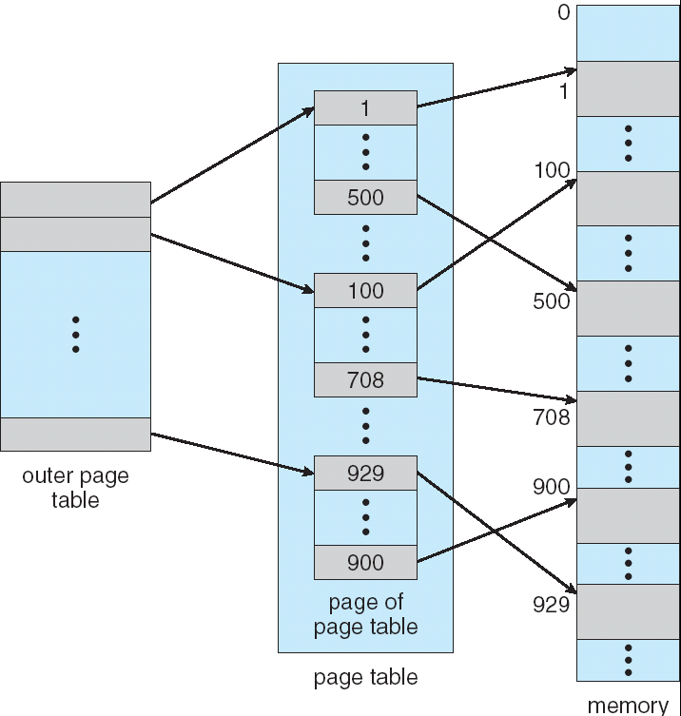
Multilevel Page Table
Memory
Break up the logical address space into multiple page tables
A simple technique is a two-level page table
Example: Two level page table
Level 1 table: each PTE points to a page table (always memory resident)
Level 2 table: each PTE points to a page (paged in and out like any other data)
Level 2
Tables
Level 1
Table
Adapted from Bryant and O’Hallaron, Computer Systems: A Programmer’s Perspective, Third Edition

Slide 34
Two-level page tables
virtual address
VPN1
VPN2
offset
physical memory
page
frame 0
Level 1
page table
physical address
PPN
offset
page
frame 1
Level 2
page table
Level 2
page table addr
page
frame 2
page
frame 3
PPN
…
page
frame Y

Slide 35
Translating with a k-level Page Table
Page table base register
(PTBR)
n-1
VIRTUAL ADDRESS
p-1
0
VPN 1
VPN 2
...
VPN k
Offset
Level 1
page table
Level 2
page table
Level k
page table
...
...
PPN
m-1
p-1
0
PPN
Offset
PHYSICAL ADDRESS
Adapted from Bryant and O’Hallaron, Computer Systems: A Programmer’s Perspective, Third Edition

Slide 36
Intel Core i7 Memory System

Slide 37
Intel Core i7 Memory System
Processor package
Core x4
Registers
Instruction
fetch
MMU
(addr translation)
L1 d-cache
32 KB, 8-way
L1 i-cache
32 KB, 8-way
L1 d-TLB
64 entries, 4-way
L1 i-TLB
128 entries, 4-way
L2 unified cache
256 KB, 8-way
L2 unified TLB
512 entries, 4-way
To other
cores
QuickPath interconnect
4 links @ 25.6 GB/s each
To I/O
bridge
L3 unified cache
8 MB, 16-way
(shared by all cores)
DDR3 Memory controller
3 x 64 bit @ 10.66 GB/s
32 GB/s total (shared by all cores)
Main memory
Adapted from Bryant and O’Hallaron, Computer Systems: A Programmer’s Perspective, Third Edition

Slide 38
End-to-end Core i7 Address Translation
CPU
32/64
L2, L3, and
main memory
Result
Virtual address (VA)
36
12
VPN
VPO
L1
hit
L1
miss
32
4
TLBTag
TLBIndex
L1 d-cache
(64 sets, 8 blocks/set)
TLB
hit
TLB
miss
...
...
L1 TLB (16 sets, 4 entries/set)
9
9
9
9
40
12
40
6
6
VPN1
VPN2
VPN3
VPN4
PPN
PPO
CT
CI
CO
Physical
address
(PA)
CR3
PTE
PTE
PTE
PTE
CT: Cache Tag
CI: Cache Index
CO: Cache Offset
Page tables
Adapted from Bryant and O’Hallaron, Computer Systems: A Programmer’s Perspective, Third Edition

Slide 39
TLBs in Datapath

Slide 40
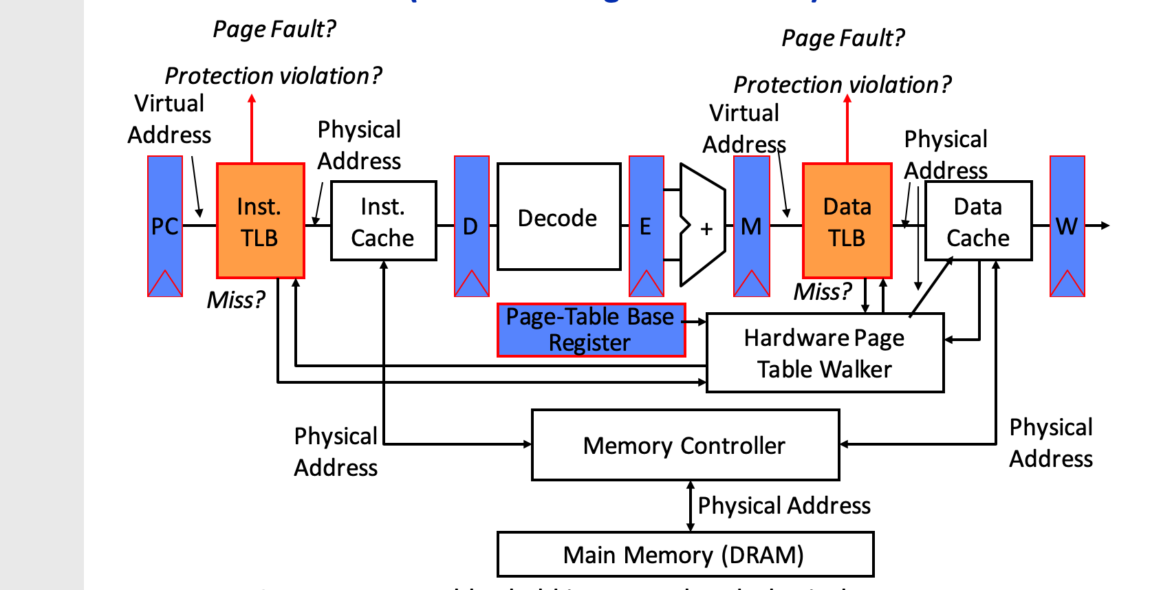
TLBs in Datapath
Ref: Morgan Rae Reschenberg, Course 61C, Univ of California, Berkeley

Slide 41
Hardware Page Table Walker
Traditional Approach (without Page Table Walker)
Processor is expected to context switch to the OS on every TLB miss, interrupting user-level execution, flushing the pipeline, and polluting caches
Hardware page table walkers (PTWs) that are used to handle TLB misses without invoking the OS
Ref: Morgan Rae Reschenberg, Course 61C, Univ of California, Berkeley

Slide 42
Address Translation
Virtual Address
hardware
hardware or software
software
TLB
Lookup
TLB Miss
TLB Hit
Page Table
“Walk”
Protection
Check
Page not
in Mem
Page
in Mem
Access
Denied
Access
Permitted
Page Fault
(OS loads page)
Update
TLB
Protection
Fault
Physical
Address
Find in Disk
Find in Mem
SEGFAULT
Check cache
Ref: Morgan Rae Reschenberg, Course 61C, Univ of California, Berkeley
Notes:
Need to restart instruction.
Soft and hard page faults.

Slide 43
Virtual Memory: Summary
Programmer’s view of virtual memory
Each process has its own private linear address space
Cannot be corrupted by other processes
System view of virtual memory
Uses memory efficiently by caching virtual memory pages
Efficient only because of locality
Simplifies memory management and programming
Simplifies protection
Virtual Memory system uses
Cache Memory for storing Page Table
TLB
Hierarchical Page Table

